Slide 1
Electrical Engineering 1
Assoc. Prof. Nguyen Binh Duong
School of Electrical Engineering- International University
Room: A2.206
Email: nbduong@hcmiu.edu.vn

Slide 2
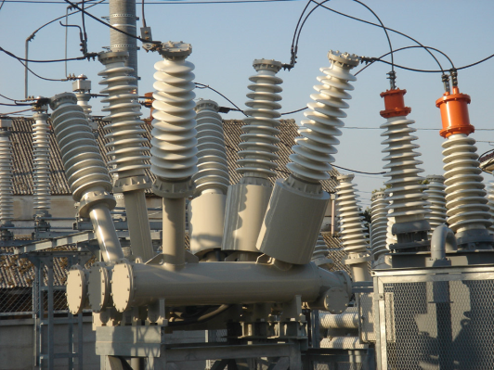

What is Electrical Engineering?
Electrical engineering is a broad field that now subdivided into a wide range of subfields including power, control systems, electronics, signal processing, telecommunications, instrumentation and microelectronics.
Source Wikipedia (The free Encyclopedia)
http://en.wikipedia.org/wiki/Electrical_engineering

Slide 3




What is Electrical Engineering

Slide 4
Course Information
Timetable
    16 sessions, 1 session per week
    After 8 sessions, a midterm exam
Course Grading
In Class Quizzes, Homework, Project 30%
Midterm Exam 30%
Final Exam 40%
  Lecture notes can be found on the Blackboard
  Students who are absent four sessions or more will be forbidden to attend the final examination.
Textbooks:
Electric Circuits, James W. Nilsson & Susan A. Riedel, 8th Edition, New Jersey

Slide 5
Course Objectives
Students who successfully fulfill the course requirements will have :
An ability to define and explain the fundamental principles of Ohm's law, Kirchhoff's Voltage Law (KCV) and Kirchhoff's current Law (KCL).
An ability to state and apply the techniques of superposition, source transformations, and Thevenin/Norton equivalent circuits to simplify the analysis of circuits and/or the computation of responses.
An ability to analyze op- amp circuits and design inverting, non-inverting, summing, and differential amplifier circuits using op- amps.
An in depth understanding of the behavior of inductances and capacitances, and differentiating and integrating op-amp circuits.
An ability to compute the steady state AC responses of basic circuits using the phasor method.
An ability to compute effective and average values of periodic signals and compute the instantaneous and average powers delivered to a circuit element.

Slide 6
CHAPTER 1 – Circuit Variables

Slide 7
What is an Electric Circuit?
“ A mathematical model that approximates the behavior of an actual circuit system.”
Note:
  Electric circuits is a component that is common between all the electric systems.
  Circuit theory is a special case of electromagnetic field theory.

Slide 8
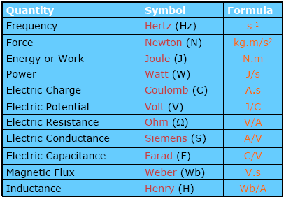
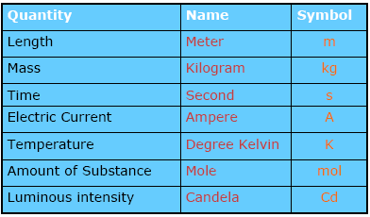
International System of Units (SI)
SI unit can be divided into two classes: base units and derived units
Base units
Derived units

Slide 9
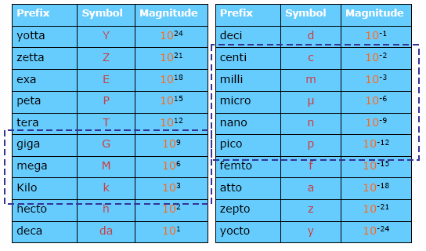
Standardized prefixes to signify powers of 10
Multiple Prefixes
Sub-multiple Prefixes

Slide 10
Rules for using prefixes
No space between the prefix symbol and the unit symbol.
    10 cm but not 10 c m
The grouping formed by the prefix symbol attached to the unit symbol constitutes a new inseparable symbol which can be raised to a positive or negative power and combined with other unit symbols to form compound unit symbol.
    1 cm³ = (10⁻² m)³ = 10⁻⁶ m³
    1 µs⁻¹ = (10⁻⁶ s)⁻¹ = 10⁶ s⁻¹
    1 V/cm = (1 V)/ (10⁻² m) = 10² V/m
    1 cm⁻¹ = (10⁻² m) ⁻¹ = 10² m⁻¹
The position of two or more SI prefixes, are not used.
    1 nm but not 1 mµm
A prefix is never used in isolation.
    10⁶ /m³ but not M/m³

Slide 11

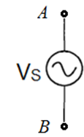




Circuit Elements
Five ideal basic circuit elements
DC Voltage source
V_{S}=V_{AB}= -V_{BA}
AC Voltage source
V_{S}=V_{AB}= -V_{BA}
Current source
I_{S}=I_{AB}= -I_{BA}
Resistor R
Inductor L
Capacitor C

Slide 12
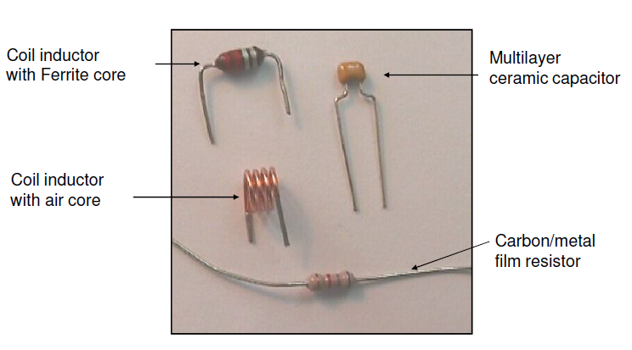
Passive Lumped Components for
Medium Frequency (up to 300MHz)

Slide 13
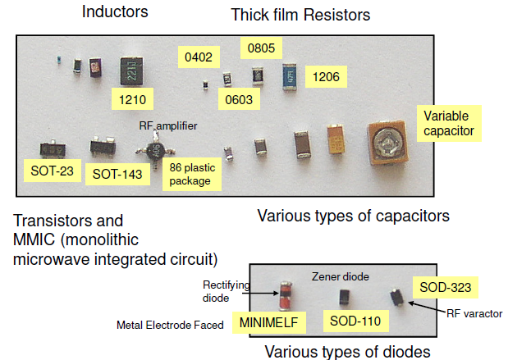
Passive Lumped Components for Ultra High Frequencies (UHF) (>300MHz)

Slide 14
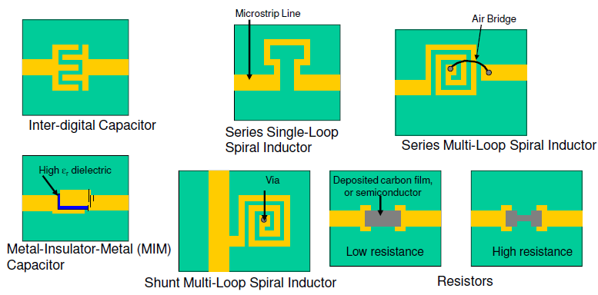
Components for Microwave Frequency Microstrip Technology

Slide 15
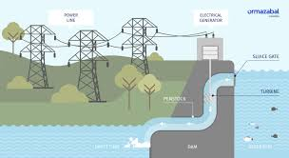
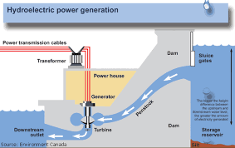
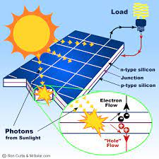
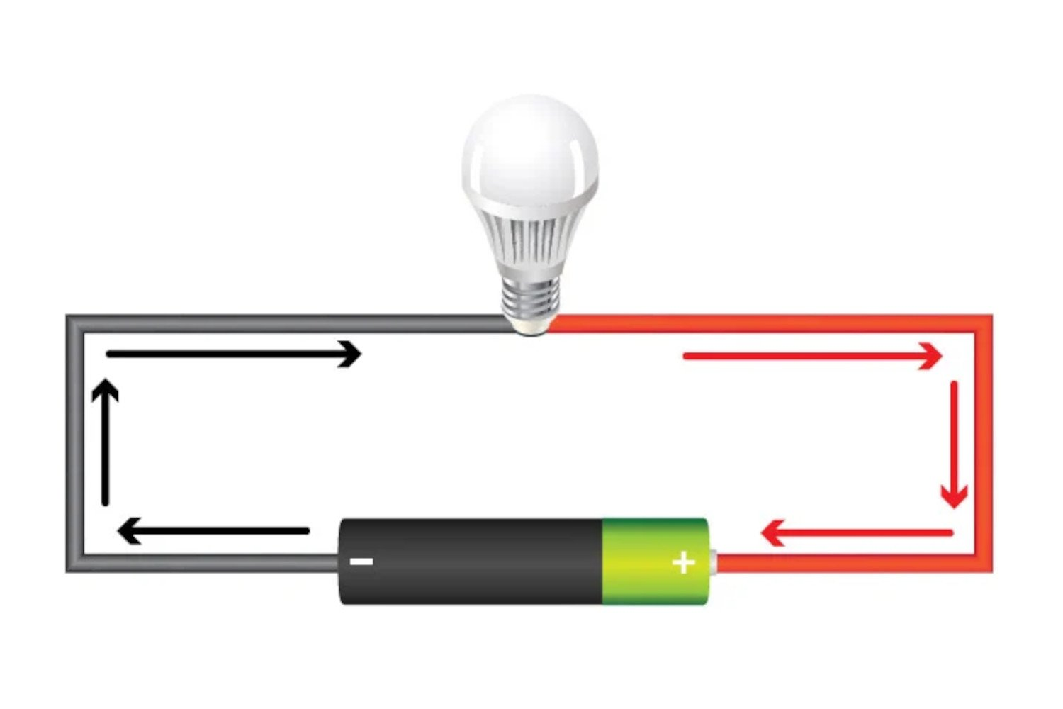
Power Source
Hydraulic Power Plant
Battery
Solar panel

Slide 16

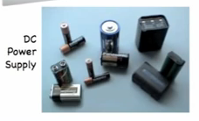

Voltage (Electric) “V”
The concept of electric charge is the basis for describing all electrical phenomena.
• The charge is bipolar, meaning that electrical effects are described in terms of positive and negative charges.
• The electric charge exists in discrete quantities, which are integral multiples of the electronic charge (proton, electron= 1.6022 × 10⁻¹⁹ C.
• The charges that occur in nature are integral multiples of the electronic charge
Force

Slide 17

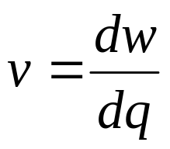
Voltage (Electric) “V”
Voltage is the amount of potential energy between two points on a circuit.
One volt is the potential difference between two points when one joule of energy is used to move one coulomb of charge from one point to another
The unit “volt” is named after the Italian physicist Alessandro Volta who invented what is considered the first chemical battery. Voltage is represented with the letter “V”.
The voltage (electric) is the energy per unit charge.
v = the voltage in volts,
w = the energy in joules,
q = the charge in coulombs.
In circuit theory, the separation of charge creates an electric force (voltage), and the motion of charge creates an electric fluid (current).

Slide 18
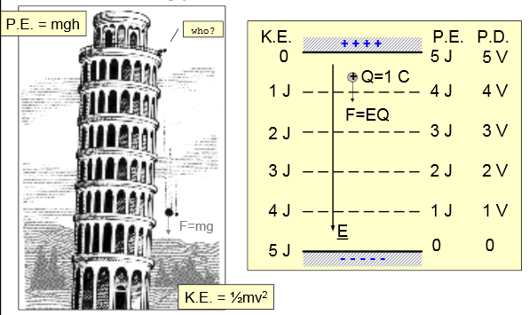
Voltage (Electric) “V”
P.E=POTENTIAL ENERGY
P.E=m.g.h
m: mass (kg)
g: acceleration of gravity
(m/s² )
h: height (m)
K.E= KINETIC ENERGY
K.E=(1/2)m.v²
m: mass (kg)
v: velocity or speed (m/s)
A potential difference of1 volt will give 1 joule of kinetic energy to a charge of 1 coulomb: Energy=Q.V
A charged particle moving in an electric field has exactly the same dynamics as a mass falling under gravity

Slide 19
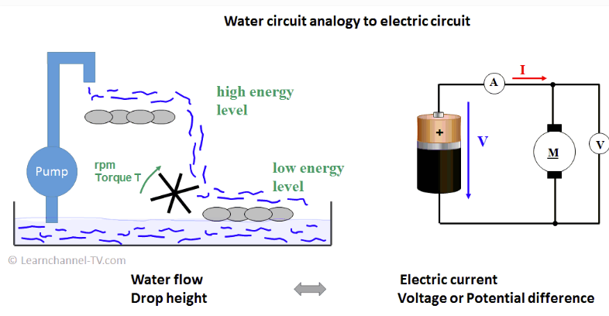

Slide 20
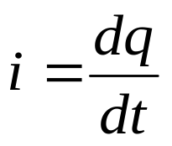
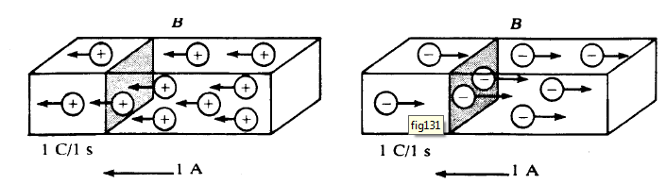
Electric Current “I”
The electrical effects caused by charges in motion depend on the rate
of charge flow. The rate of charge flow is known as the electric current,
which is expressed as
i = the current in amperes,
q = the charge in coulombs,
t = the time in seconds.
C/s or (A)
Thus in a current of 1 ampere, charge is being transferred at a rate of 1 coulomb per second

Slide 21
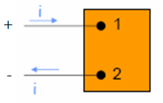
The ideal basic circuit element
Attributes of the ideal basic circuit element:
    It has only two terminal
    It is described mathematically in terms of current and/or voltage
    It cannot be subdivided into other elements.
Note:
    It is called ideal because it does not exist as a realizable physical component.

Slide 22
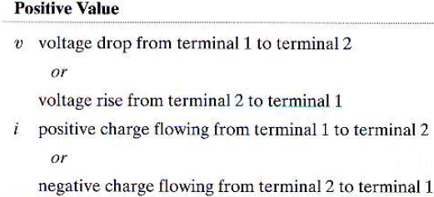

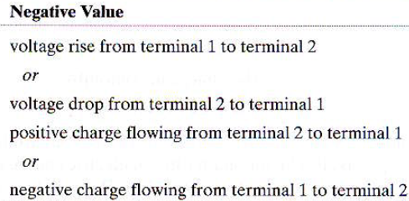
Interpretation of Reference Directions
The passive sign convention

Slide 23

Example 1.1
No charge exists at the upper terminal of the element in Fig. for t < 0. At t = 0, a 5 A current begins to flow into the upper terminal.
a) Derive the expression for the charge accumulating at the upper terminal of the element for t > 0.
b) If the current is stopped after 10 seconds, how much charge has accumulated at the upper terminal?

Slide 24


Solution
From the definition of current, the expression for charge accumulation due to current flow is
Therefore,
b) The total charge that accumulates at the upper terminal in 10 seconds due to a 5 A current is q(10) = 5(10) = 50 C.

Slide 25
Example 1.2
The current at the terminals of the element in Fig is:
i = 0, t < 0;
i = 20e^{-5000t} A, t ≥ 0.
Calculate the total charge (in microcoulombs) entering the element at its upper terminal.

Slide 26
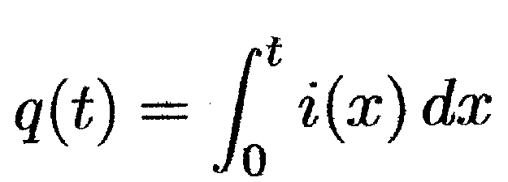
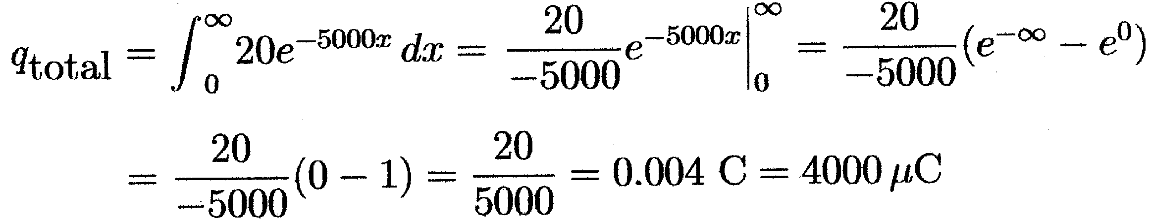
Solution
Current is the time rate of change of charge, or i = dq/dt. In this problem, we are given the current and asked to find the total charge. To do this, we must integrate the equation to find an expression for charge in terms of currents:
We are given the expression for current, i, which can be substituted into the above expression. To find the total charge, we let t → ∞ in the integral. Thus we have:

Slide 27

Example 1.3
The expression for the charge entering the
upper terminal of Fig is
Find the maximum value of the current entering
the terminal if α = 0.03679 s⁻¹.

Slide 28
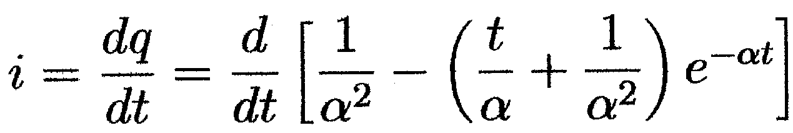
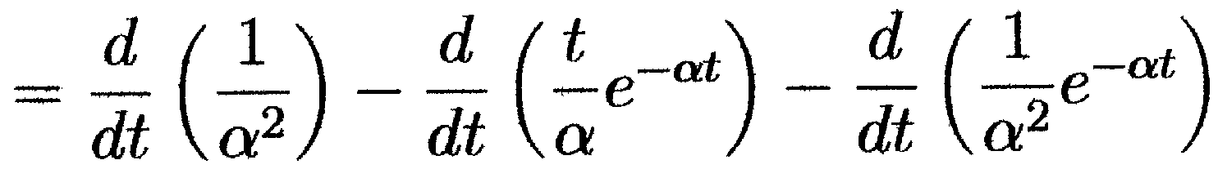
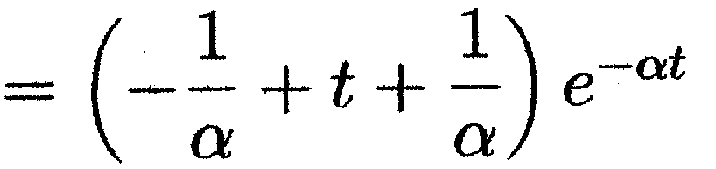

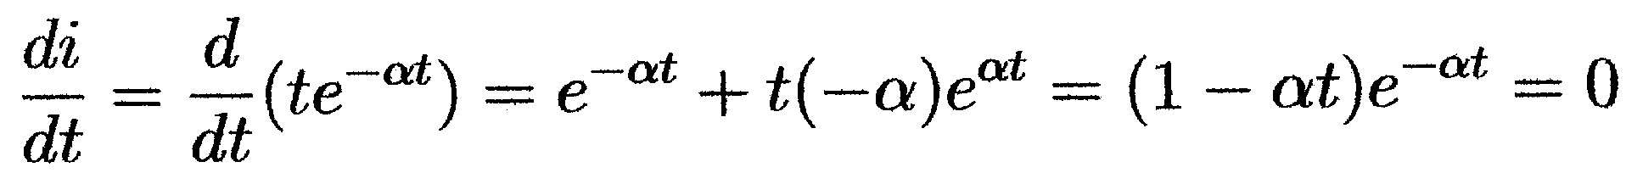
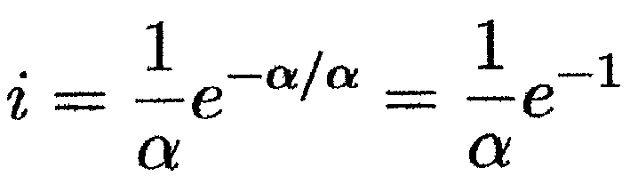
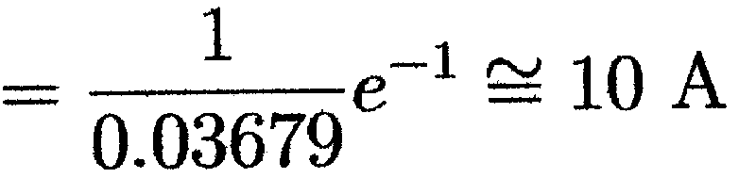
Solution
Again, current is the time rate of change of charge, or i = dq/dt. In this problem we are given an expression for the charge, and asked to find the maximum current. First, we will find an expression for the current using the equation:
Now that we have an expression for the current, we can find the maximum value of the current by setting the first derivative of the current to zero and solving for t:
Since e-αt never equals 0 for a finite value of t, the expression equals 0 only when (1 - αt) = 0. Thus, t = 1/α will cause the current to be maximum. For this value of t, the current is:

Slide 29
Active and Passive Elements
Active element is one that models a device that is capable of generating electric energy
Example: Sources
Passive element is one that models a device that cannot generate electric energy
Example: Resistors, inductors and capacitors

Slide 30
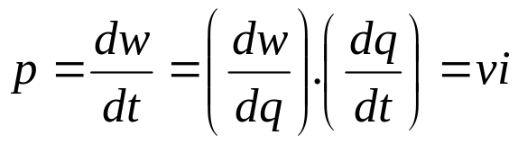
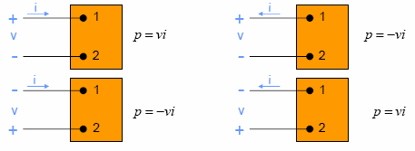
Power and Energy
Power and energy calculations also are important in circuit analysis.
Power is the time rate of expanding or absorbing energy
p = the power in watts,
w = the energy in joules,
t = the time in seconds.
p = the power in watts,
v = the voltage in volts,
i = the current in amperes.
If the current reference is in the direction of a reference voltage rise across the terminals, the expression for the power is p = - vi
If the power is positive (that is, if p > 0), power is being delivered to the circuit inside the box.
If the power is negative (that is, if p < 0), power is being extracted from the circuit inside the box.
If we use the passive sign convention, Eq. is correct if the reference direction for the current is in the direction of the reference voltage drop across the terminals

Slide 31
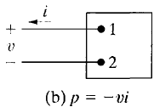
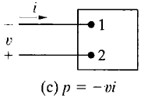
For example, suppose that we have selected the polarity references
shown in Fig. (b). Assume further that our calculations for the current
and voltage yield the following numerical results:
i = 4 A and v = -10 V.
Then the power associated with the terminal pair 1,2 is
p = -(-10)(4) = 40 W.
Thus the circuit inside the box is absorbing 40 W.
If we choose the reference polarities shown in
Fig. (c). The resulting numerical values are
i = -4 A, v = 10 V, and p = 40 W.
Note that interpreting these results in terms of this reference system gives
the same conclusions that we previously obtained—namely, that the circuit
inside the box is absorbing 40 W.

Slide 32
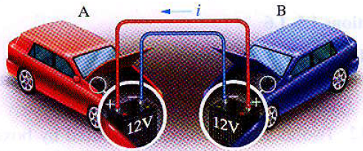
Example 1.4
When a car has a dead battery, it can often be started by connecting the battery from another car across its terminals. The positive terminals are connected together as are the negative terminals. The connection is illustrated in the Figure. Assume the current i in the Figure is measured and found to be 30 A.
a) Which car has the dead battery (power of battery)?
b) If this connection is maintained for 1 min, how much energy is transferred to the dead battery?

Slide 33
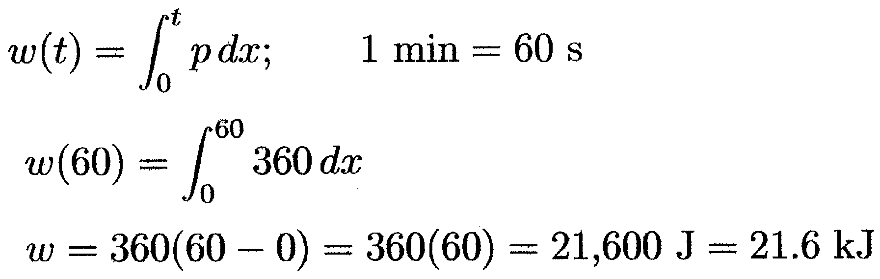
Solution
In car A, the current i is in the direction of the voltage drop across the 12 V battery (the current i flows into the + terminal of the battery of car A). Thus using the passive sign convention,
p = vi = 30 × 12 = 360 W
since the power is positive, the battery in car A is absorbing power, so car A must have the “dead” battery.
b)

Slide 34
CHAPTER 2 – Circuit Elements
There are five ideal basic circuit elements:
  resistors,
  voltage sources,
  current sources,
  inductors, and
  capacitors.

Slide 35
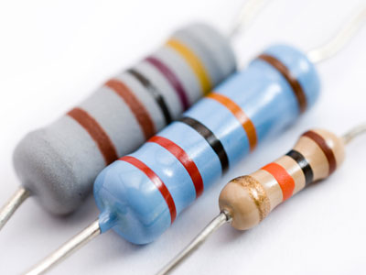

Electrical Resistance
Resistance is the capacity of materials to holdback the flow of current or, more specifically, the flow of electric charge.
The circuit element used to model this behavior is the resistor.
R

Slide 36
Voltage and current sources
An electrical source is a device that is capable of converting non-electric energy to electric energy and vice versa.
Example: battery, generator, etc.
Ideal voltage and current sources
  An ideal voltage source is a circuit element that maintains a prescribed voltage across its terminal regardless of the current flowing in those terminals.
  An ideal current source is a circuit element that maintains a prescribed current across its terminal regardless of the voltage across those terminals.

Slide 37




Independent and dependent sources
An independent source establishes a voltage or current without relying on voltage or currents elsewhere in the circuit.
A dependent source establishes a voltage or current whose value depends on the value of a voltage or current elsewhere in the circuit.
Voltage source
Current source
Controlled voltage source
Controlled current source

Slide 38
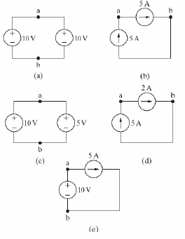
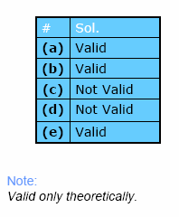
Example 2.1
Which connection is valid and which is not?

Slide 39
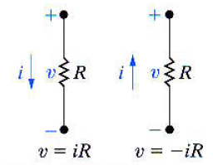

Ohm’s Law
It is the algebraic relationship between voltage and current for a resistor
v = iR
v = the voltage in volts
i = the current in amperes
R = the resistance in ohms (Ω)

Slide 40
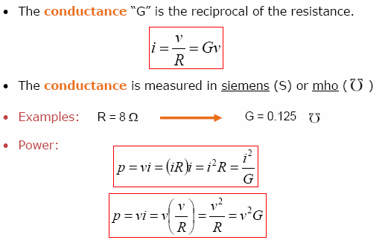
Ohm’s Law

Slide 41
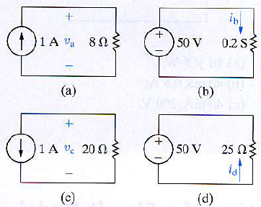
Example 2.2
In each circuit in the Figure, either the value of v or i is not known.
a) Calculate the values of v and i.
b) Determine the power dissipated in each resistor.

Slide 42
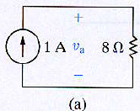
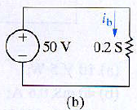
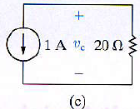
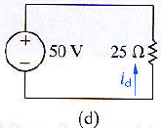
Solution
a) The voltage v_{a} in Fig. (a) is a drop in the direction of the current in the resistor. Therefore, V_{a} = (1)(8) = 8 V.
The current i_{b} in the resistor with a conductance
of 0.2 S in Fig. (b) is in the direction of the
voltage drop across the resistor. Thus
i_{b} = (50)(0.2) = 10 A.
The voltage v_{c} in Fig. (c) is a rise in the direction of the current in the resistor. Hence v_{c} = -(1)(20) = -20 V.
The current i_{d} in the 25 Ω resistor in Fig. (d)
is in the direction of the voltage rise across the
resistor. So i_{d} = - 50/25 = - 2 A

Slide 43
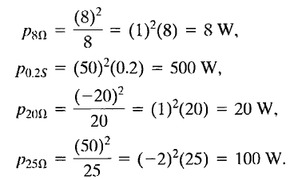
b) The power dissipated in each of the four resistors is

Slide 44
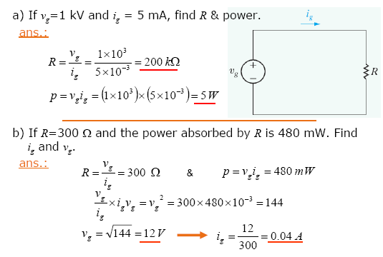
Example 2.3

Slide 45
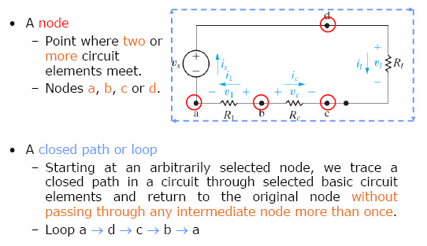
Kirchhoff’s Law

Slide 46
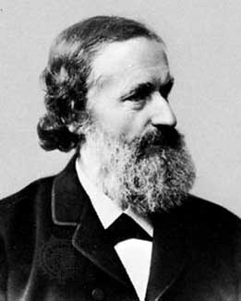
Kirchhoff’s Law
Kirchhoff’s Current Law (KCL)
The algebraic sum of all the currents at any node in the circuit equals zero
The sum of the currents entering any node must equal the sum of the currents leaving that node
Kirchhoff’s Voltage Law (KVL)
The algebraic sum of all the voltages around any close path equals a zero
The sum of the potential difference across all elements around any closed loop must be zero

Slide 47
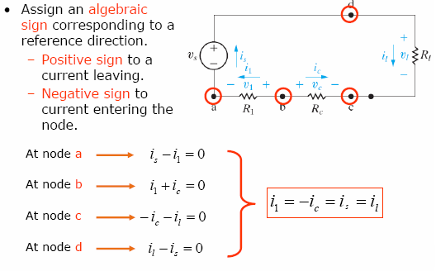
Kirchhoff’s Current Law
Note:
In any circuit with n nodes, n – 1 independent current equations can be derived from Kirchhoff’s current law.

Slide 48

Kirchhoff’s Voltage Law

Slide 49


Kirchhoff’s Law

Slide 50

Example 2.4
Sum the currents at each node in the circuit shown in Figure. Note that there is no connection dot (•) in the center of the diagram, where the 4 Ω branch crosses the branch containing the ideal current source i_{a}.
In writing the equations, we use a positive sign for a current leaving a node. The four equations are

Slide 51

Example 2.5
Sum the voltages around each designated path in the circuit shown in Figure
In writing the equations, we use a positive sign for a voltage drop. The four equations are

Slide 52

Example 2.6

Slide 53

Example 2.6 (cont.)

Slide 54

Example 2.6 (cont.)

Slide 55

Circuit containing dependent sources

Slide 56

Example 2.7

Slide 57

Example 2.8

Slide 58

Example 2.9

Slide 59

Solution

Slide 60


Calculate power using the formula p = Ri²:
Sum the power dissipated by the resistors:
The power associated with the sources is
Thus the total power dissipated is 1310 + 400 = 1710 W and the total power
developed is 1710 W, so the power balances.

